Slide 1
Annotating intonation units in the Taiwan Mandarin Corpus
Ryan Ka Yau Lai
University of California, Santa Barbara

Slide 2
Intonation units

Slide 3

What’s an IU?
A problem of assigning boundaries to speech
Empirically driven (not interested in lab-grown speech) (vs. intonation phrase)

Slide 4

What’s an IU?
‘Subjective’ cue trading needed – not based on a single cue
Pauses: Not as important as you might think
(Phonetic cues only – not syntactic or lexical cues!)

Slide 5

What’s an IU?
From the speaker’s perspective: a unit of planning
From the both parties’ perspectives: the focus of consciousness at any time

Slide 6

When did you get into a living relationship with those artists in Paris at what age with artists in Paris yes uhm I went to study art in Paris a little bit uh but I really didn’t meet any answers and to answer your question the way I think you would like it answered I was twenty-three In New York
(SBC055 – The Mada of Dada)

Slide 7
Perrot: When did you get into a living relationship with those artists in Paris
At what age
Wood: with artists in Paris
Perrot: Yes
Wood: Uhm
I went to study art in Paris
A little bit
Uh But I really didn’t meet any answers
And to answer your question the way I think you would like it answered
I was twenty-three
In New York

Slide 8
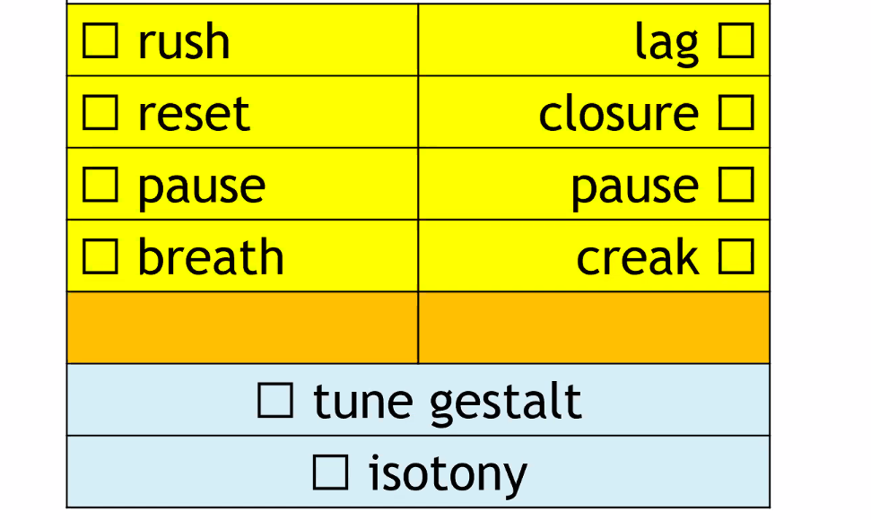
The start of an IU is often characterised by faster speed
The end of an IU is often characterised by slower speed
IUs often start by restarting the pitch range
Is there a final rise / fall?
IUs often start/end with a pause
The end of an IU often has creaky voice
IUs often start with breath
Is there a specific melody?
Is there a similar intonation contour across multiple IUs?

Slide 9
Um with our other penguins uh we brought them over from Scotland and as it turned out in the quarantine period that they had that a vi- I should say a fungus okay this aspergillosis fungus had come to fruition and we had lost you know a good portion of penguins so okay now it’s time to consider replacing these penguins how do we wanna go about doing that
(SBC039 – Pretty Busy Bird)

Slide 10
Um
With our other penguins
uh
We brought them over from Scotland
and
As it turned out
In the quarantine period that they had
That
A vi-
I should say a fungus
Okay this Aspergillosis fungus
Had come to fruition
And
we had lost
You know a good portion of penguins
So
Okay
Now it’s time to consider replacing these penguins
How do we wanna go about doing that
Notes:
Rush, slowdown, breath – with our other penguins
Now it’s time to consider replacing these penguins (RESET) How do we wanna go about doing that
A vi – closure, pause
Isotony – I should say a fungus, okay this Aspergillosis fungus
Tune gestalt – how do we wanna go

Slide 11
Tell me how many IUs …
Notes:
Rush, slowdown, breath – with our other penguins
Now it’s time to consider replacing these penguins (RESET) How do we wanna go about doing that
A vi – closure, pause
Isotony – I should say a fungus, okay this Aspergillosis fungus
Tune gestalt – how do we wanna go

Slide 12
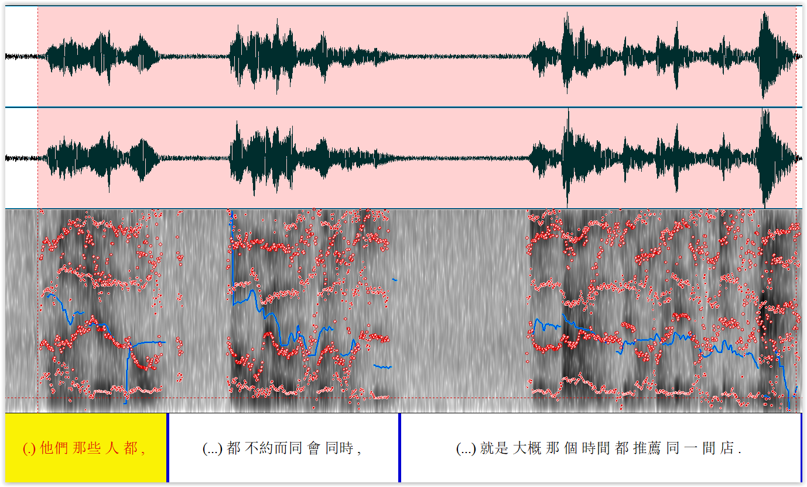
Meaning/Grammar can be misleading
Notes:
Rush, slowdown, breath – with our other penguins
Now it’s time to consider replacing these penguins (RESET) How do we wanna go about doing that
A vi – closure, pause
Isotony – I should say a fungus, okay this Aspergillosis fungus
Tune gestalt – how do we wanna go

Slide 13
Tell me how many IUs …
Notes:
Rush, slowdown, breath – with our other penguins
Now it’s time to consider replacing these penguins (RESET) How do we wanna go about doing that
A vi – closure, pause
Isotony – I should say a fungus, okay this Aspergillosis fungus
Tune gestalt – how do we wanna go

Slide 14
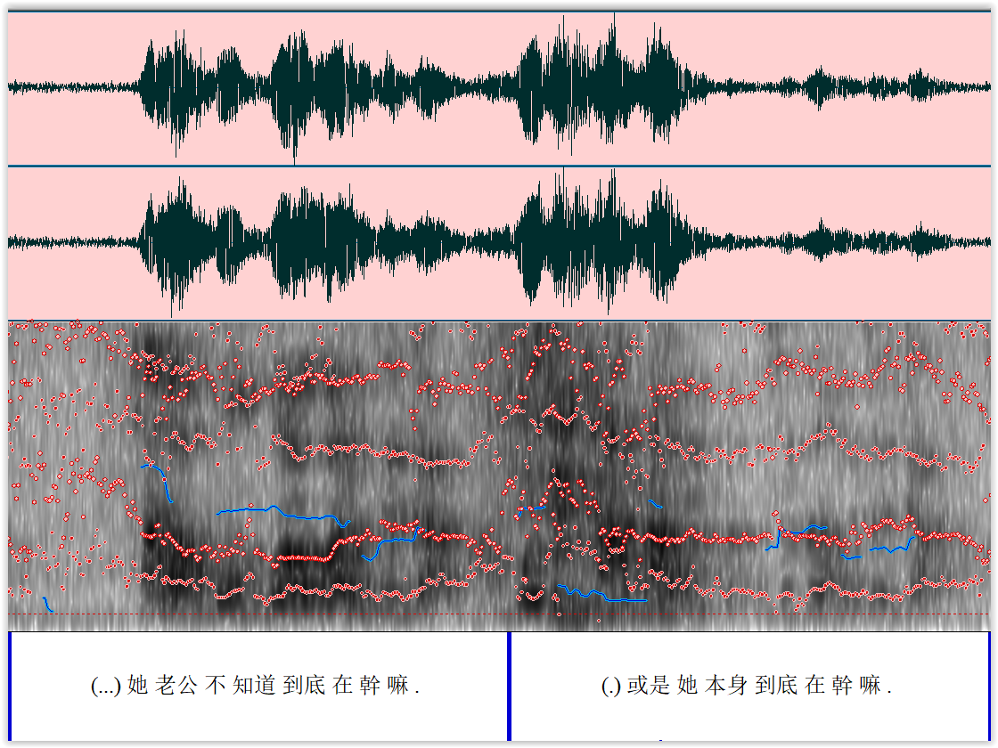
Pitch
Notes:
Rush, slowdown, breath – with our other penguins
Now it’s time to consider replacing these penguins (RESET) How do we wanna go about doing that
A vi – closure, pause
Isotony – I should say a fungus, okay this Aspergillosis fungus
Tune gestalt – how do we wanna go

Slide 15
Tell me how many IUs …

Slide 16
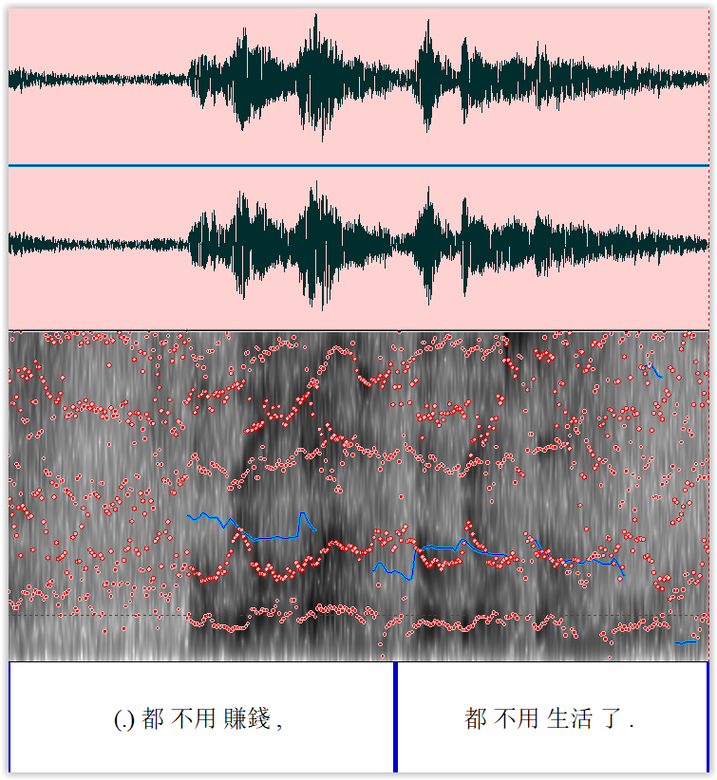
Isotony

Slide 17
Endnotes (i.e. prosodic types of IUs)

Slide 18


What’s an endnote?
Informally: ‘Punctuation marks’
Give the intonational type of the IU, especially near the end
Remember: This is about sound, especially pitch; not meaning!
Four types of endnotes:
Continuining (‘comma’, stable): ,
Appeal (‘question mark’, rising): ?
Statement (‘period’, falling): ?

Slide 19
Four types of endnotes
,
Continuing (‘comma’, stable)
,
?
Appeal (‘question mark’, rising)
.
Statement (‘period’, falling)
--
Truncation (‘dash’, when you feel the IU was not finished)

Slide 20
Perrot: When did you get into a living relationship with those artists in Paris
At what age
Wood: with artists in Paris
Perrot: Yes
Wood: Uhm
I went to study art in Paris
A little bit
Uh But I really didn’t meet any answers
And to answer your question the way I think you would like it answered
I was twenty-three
In New York

Slide 21
Perrot: When did you get into a living relationship with those artists in Paris,
At what age.
Wood: with artists in Paris.
Perrot: Yes.
Wood: Uhm,
I went to study art in Paris.
A little bit.
Uh But I really didn’t meet any answers.
And to answer your question the way I think you would like it answered,
I was twenty-three.
In New York.

Slide 22
Um
With our other penguins
uh
We brought them over from Scotland
and
As it turned out
In the quarantine period that they had
That
A vi-
I should say a fungus
Okay this Aspergillosis fungus
Had come to fruition
And
we had lost
You know a good portion of penguins
So
Okay
Now it’s time to consider replacing these penguins
How do we wanna go about doing that
Notes:
Rush, slowdown, breath – with our other penguins
Now it’s time to consider replacing these penguins (RESET) How do we wanna go about doing that
A vi – closure, pause
Isotony – I should say a fungus, okay this Aspergillosis fungus
Tune gestalt – how do we wanna go

Slide 23
Um,
With our other penguins,
Uh,
We brought them over from Scotland,
And,
As it turned out ,
In the quarantine period that they had,
That,
A vi- --
I should say a fungus,
Okay this Aspergillosis fungus,
Had come to fruition,
And,
we had lost,
You know a good portion of penguins.
So,
Okay,
Now it’s time to consider replacing these penguins,
How do we wanna go about doing that.
Notes:
Rush, slowdown, breath – with our other penguins
Now it’s time to consider replacing these penguins (RESET) How do we wanna go about doing that
A vi – closure, pause
Isotony – I should say a fungus, okay this Aspergillosis fungus
Tune gestalt – how do we wanna go

Slide 24
Tell me the endnote …

Slide 25
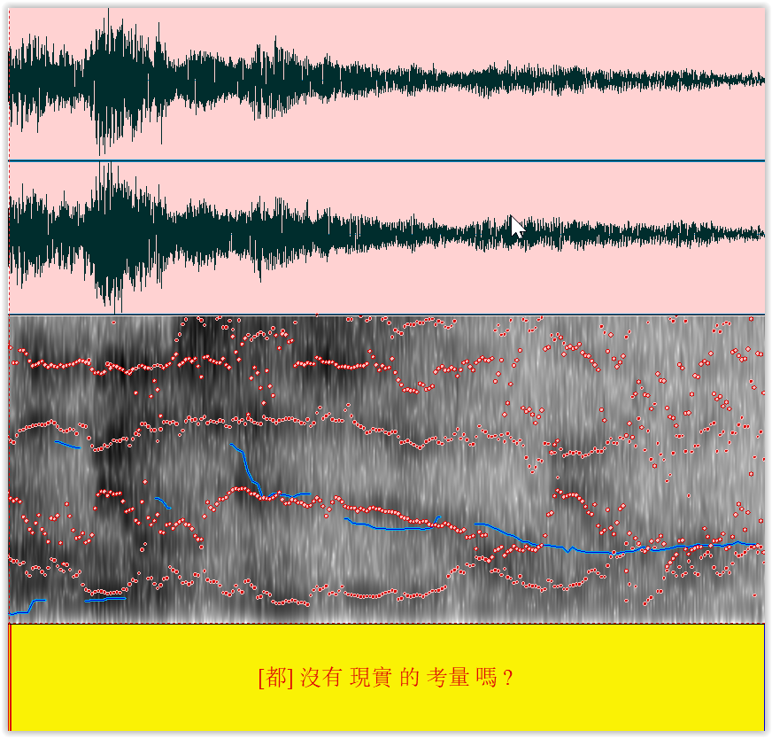
What counts as rise? The tone
The F0 is actually not increasing much
But 第二聲 normally ends higher than 輕聲
‘Stable’ pitch contour is a rise
When you think about whether something has risen / fallen, think about the TYPICAL pitch taking the tone into consideration, then whether it’s rising / falling

Slide 26
Tell me the endnote …

Slide 27
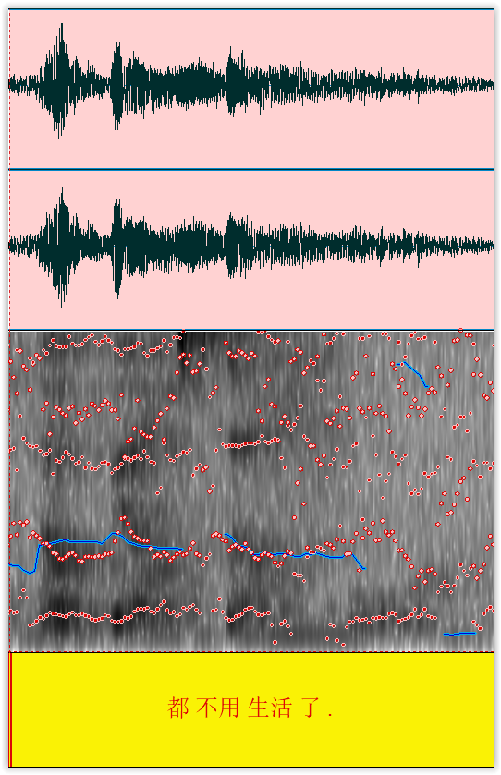
Careful of creaks!
Sometimes, you can’t hear the fall directly
Because it’s creaky voice instead
活 is very low here!

Slide 28
IU annotation in Rezonator

Slide 29
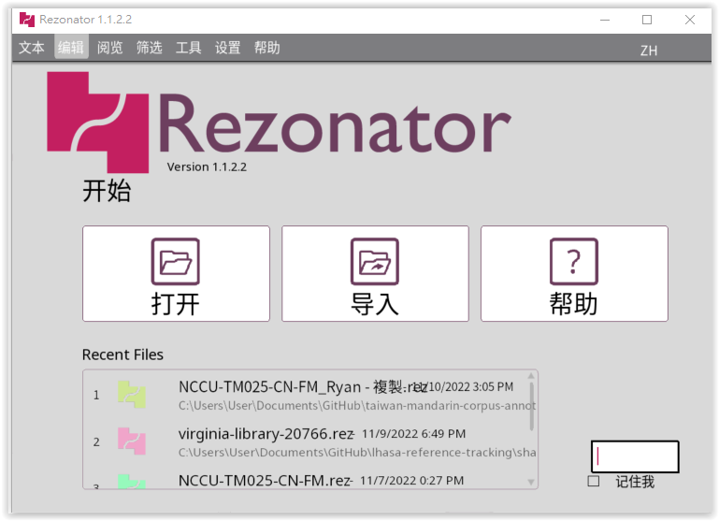
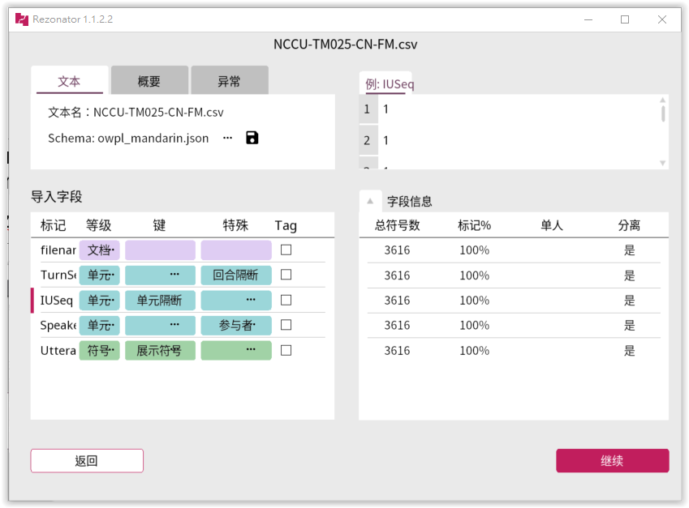
Importing into Rezonator
Use the file 5_dft_convert.R to convert your FINAL tokenisation into DFT format in the 5_dft_converted folder
Use the file 6_to_rez.R to convert the DFT-formatted file in 5_dft_converted into owpl (one-word-per-line) .csv format in the 6_to_rez folder
Import the owpl .csv in the 6_to_rez folder into Rezonator using the owpl_mandarin.json schema file

Slide 30
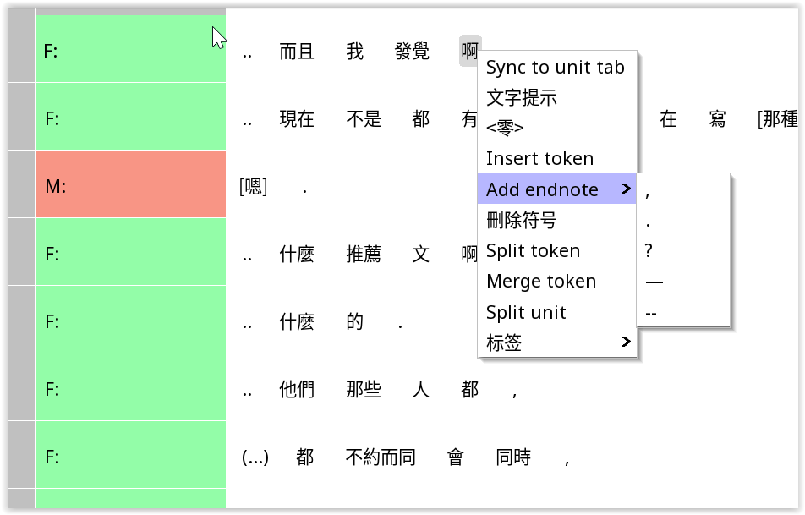
Adding endnotes
Right-click the LAST word of the IU, and then go to Add endnoe

Slide 31
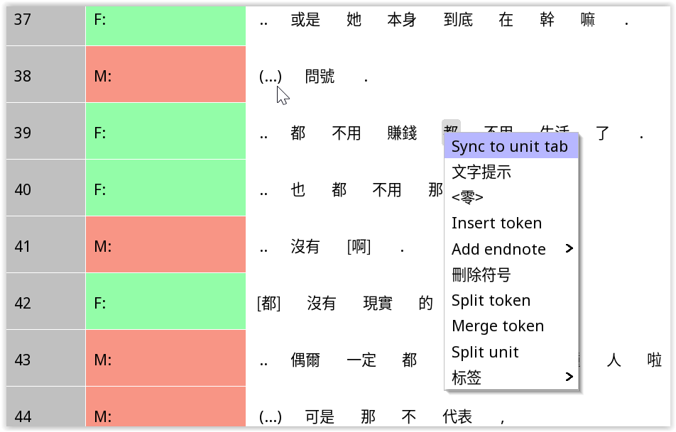

Splitting units
Right-click the FIRST word of the second IU

Slide 32
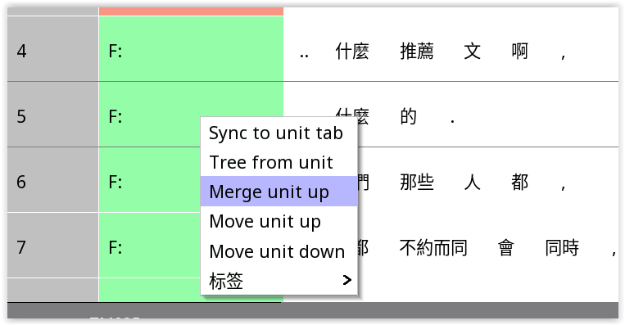
IU merging
Right click on the SECOND IU

Slide 33
Tokenisation / text errors
You can still fix them at this stage
BUT you must write down the changes you make & make sure your partner also makes them
It is highly important that both of you end up with the same text, differing only in boundaries

Slide 34
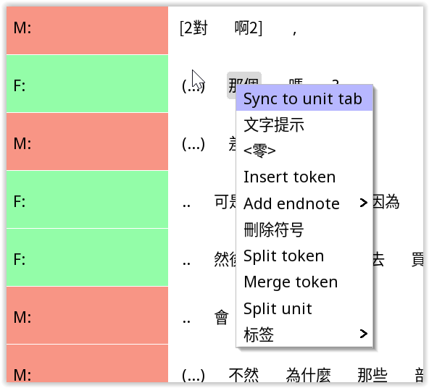

Token split
Right click on the token
You will be asked to insert a space

Slide 35
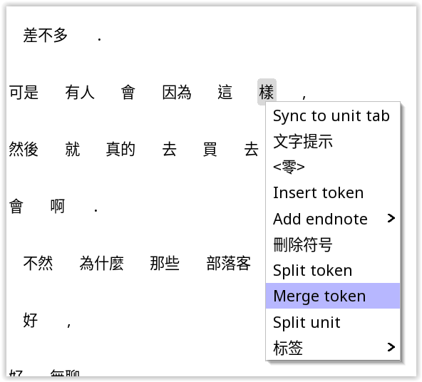
Token merge
Right click on token
Click ‘Merge token’

Slide 36
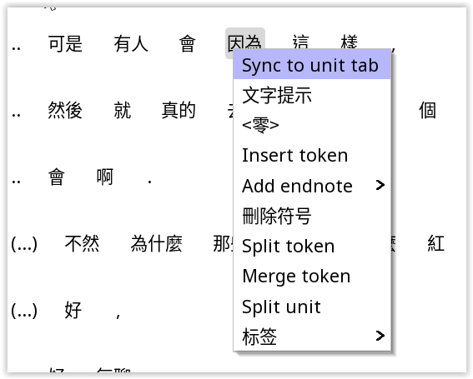
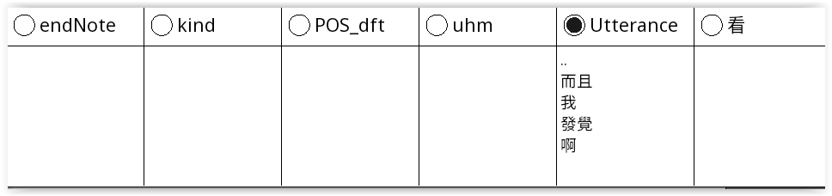
Text errors
Click ‘Sync to unit tab’
Double-click cell in the top right to change

Slide 37
When you see @@@
If the IU is just @@@: then no need to put an endnote
If the IU ends in @@@: Please put the endnote after the @@@
For example: 我 很 開心 @@@ ?

